Slide 1

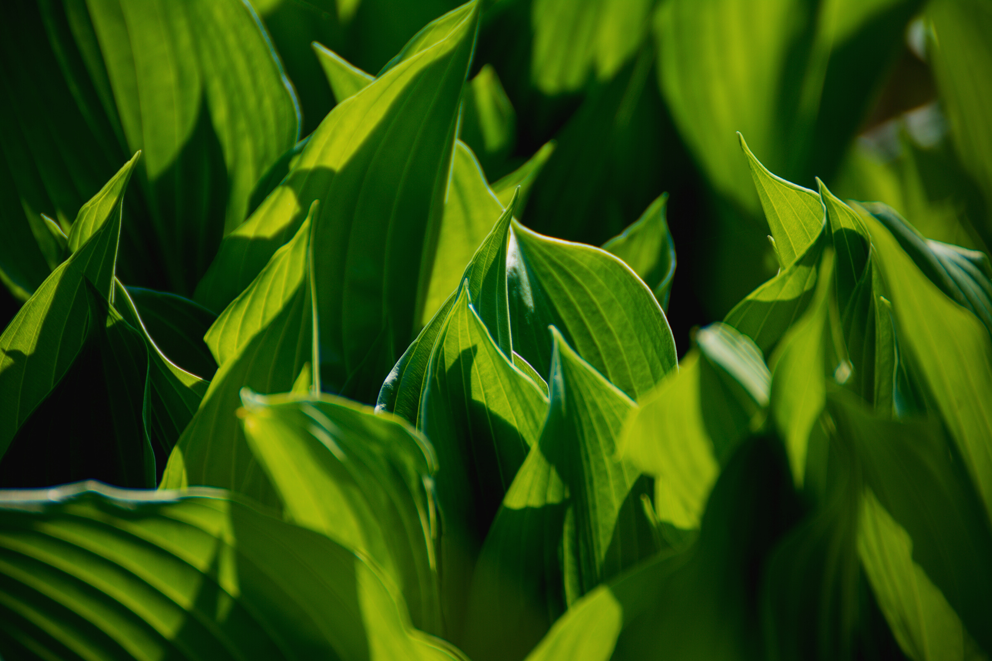
Automation of Crop Disease Detection through Conventional Machine Learning and Deep Transfer Learning Approaches

Slide 2


Authors:
H. Oulhaj,
M. Sabri,
M. Khaldi,
E. Sayed

Slide 3
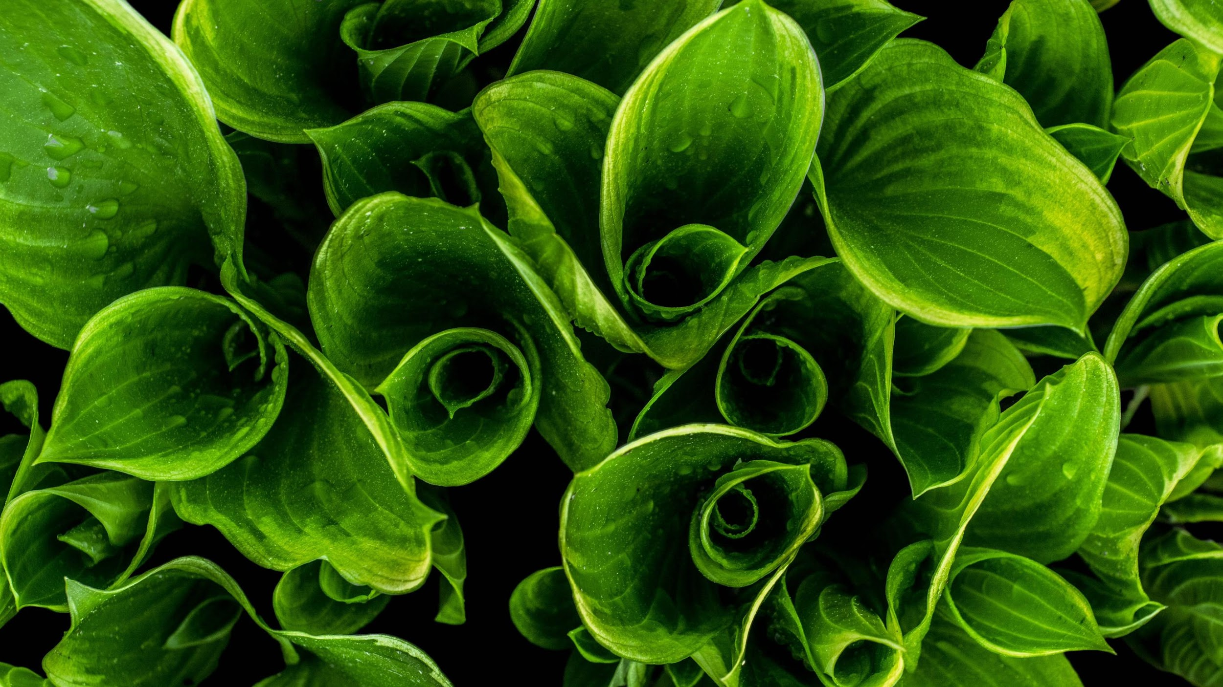
Introduction
Background:
Agricultural productivity relies on effective crop disease detection.
Current models face challenges in real-life scenarios due to the absence of annotated datasets from such environments.

Slide 4
Research Objective
Motivation/Purpose/Aims/Hypothesis:
Motivation: Overcome limitations in existing crop disease detection models.
Purpose: Conduct a comprehensive comparative analysis of Deep Learning (DL) and Machine Learning (ML) models.
Aims:
Evaluate the performance of state-of-the-art DL models (CNN, InceptionV3) against traditional ML models (KNN, SVM, RF).
Identify strengths and weaknesses of each model in the context of crop disease detection.
Hypothesis: DL models will demonstrate superior performance in terms of accuracy and feature extraction.

Slide 5
Contributions
Conducted an exhaustive comparative study involving cutting-edge DL and ML models.
Explored improvements by employing various activation functions and deep learning optimization algorithms.

Slide 6



Methodology
Utilized DL models: Convolutional Neural Network (CNN) and InceptionV3.
Employed ML models: K-Nearest Neighbors (KNN), Support Vector Machine (SVM), Random Forest (RF).
Experimented with pre-trained models to optimize efficiency and reduce computational load during training.

Slide 7
Deep Learning Models
Convolutional Neural Network (CNN)
Architecture:
Multiple convolutional and pooling layers for feature extraction.
Fully connected layers for classification.
Results:
High accuracy observed in identifying crop diseases.
Robust feature extraction from images.

Slide 8
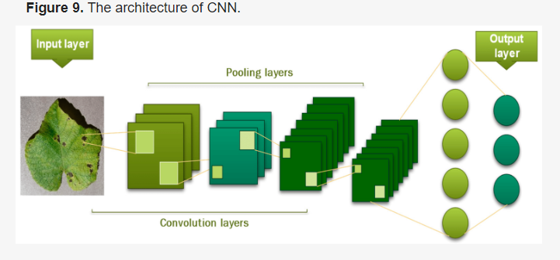

Slide 9


Deep Learning Models (contd.)
InceptionV3
Architecture:
Utilizes inception modules for efficient information capture.
Global Average Pooling for spatial feature extraction.
Performance:
Demonstrated high accuracy and efficient learning compared to traditional ML models.

Slide 10
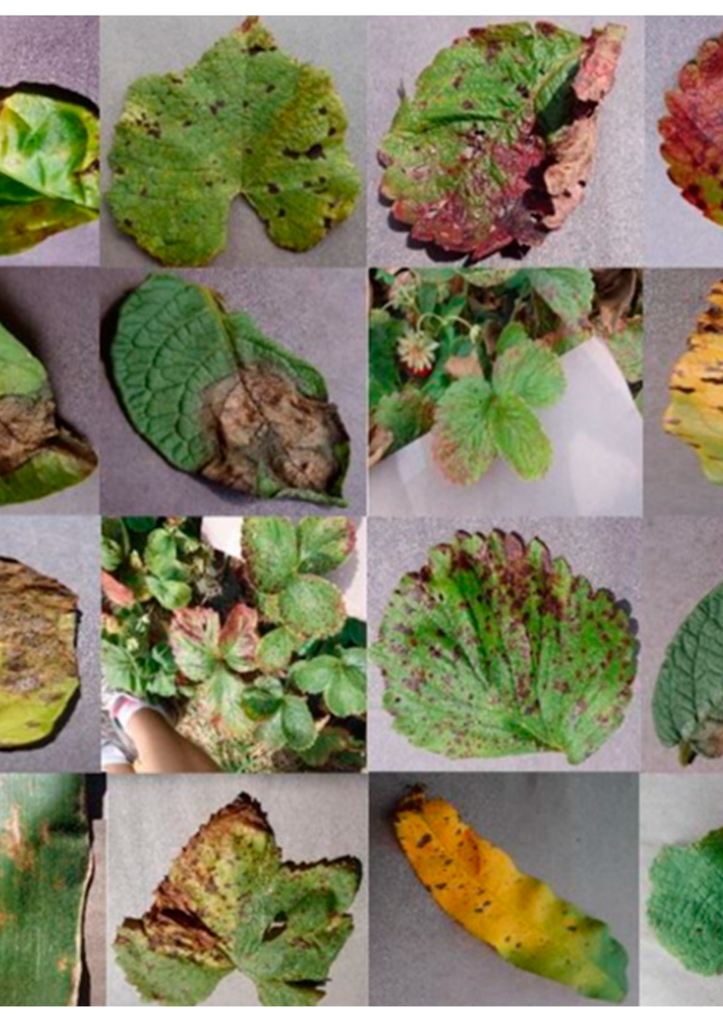
An overview of some crop leaf images selected randomly from the PlantVillage dataset.

Slide 11
Machine Learning Models
K-Nearest Neighbors (KNN)
Challenges Encountered:
Sensitivity to noise during training.
Requires manual tuning of the number of neighbors.

Slide 12
Machine Learning Models (contd.)
Support Vector Machine (SVM)
Challenges Encountered:
Critical choice of kernel function impacting results.
Limited ability to recognize multiple diseases in an image.

Slide 13
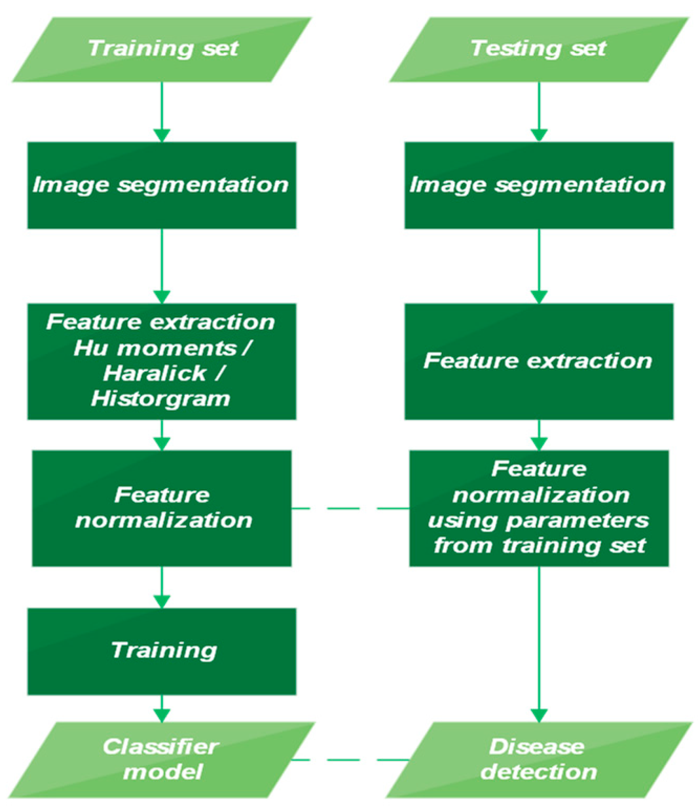
Diagram illustrating the training and testing phases.

Slide 14
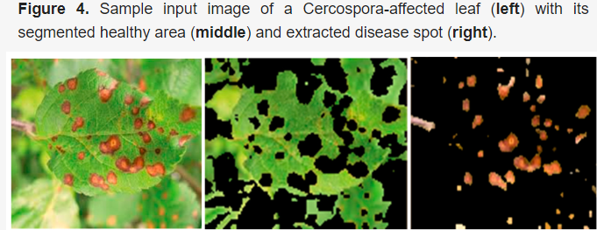
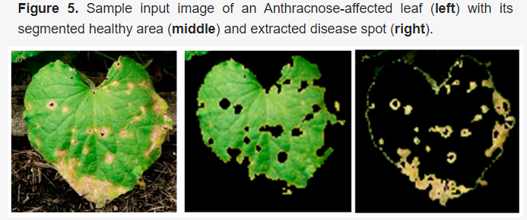
Calculation of Haralick texture features.

Slide 15
Random Forest (RF)
Advantages:
Ensemble learning for improved accuracy.
Overcomes some challenges of KNN and SVM.
Considerations:
Computational efficiency compared to DL models.

Slide 16
Challenges
Dataset Limitations:
Absence of images from real-life scenarios.
Training conducted on images captured in controlled environments.
Model-Specific Issues:
KNN's sensitivity to noise.
SVM's dependency on the choice of the kernel function.

Slide 17
Limitations
First Limitation/Critique:
Dependency on controlled environments for dataset creation.
Proposal: Inclusion of a new dataset with labeled images from real-world scenarios.
Second Limitation/Critique:
Challenges in KNN and SVM related to noise sensitivity and kernel function choice.
Proposal: Experimentation with hybrid data augmentation techniques using Generative Adversarial Network (GAN) architecture to enhance disease detection.

Slide 18

Synthesis
Data Enhancement Proposals:
Inclusion of new datasets with labeled images from real-world scenarios.
Exploration of synthesized and generated images using GAN architecture for enhanced disease detection in real-world scenarios.
Model Selection Considerations:
No one-size-fits-all solution.
Model selection based on specific applications and dataset sizes.

Slide 19
Conclusion
Key Findings:
DL models demonstrate dominance in accuracy and feature extraction.
Consideration of computational costs and resource requirements.
Recommendation: Hybrid models (e.g., SGD optimizer + swish activation + RF + InceptionV3).
Future Directions:
Implementation of a web application with a hybrid model for field validation.
Forum creation for farmers and agronomists for discussions on treatments and precautions.

Slide 20
Acknowledgments
Acknowledgments:
Research conducted within the framework of the "Agrometeorological Stations Platform" project funded by the Moroccan Ministry of Higher Education and Scientific Research-National Centre for Scientific and Technical Research (NCSTR) (PPR2 project)

Slide 21
Thank you
Open the floor for questions from the audience.

